Slide 1












VICTIMIZATION AND CLASSIFICATION OF RIPE FRUIT USING MACHINE LEARNING
@centuriton
@centuriton
@centuriton
t.me/centuRITon
www.centuriton.com

Slide 2

IDEA OVERVIEW
VICTIMIZATION AND CLASSIFICATION OF RIPE FRUIT
MACHINE LEARNING
One of the most important industries in any country is the agricultural sector. However, in some countries, farmers and ﬁshermen have limited technology compared to other developed Countries. One of the eﬀects of limited technology the quality of crops, fruits, and vegetables is low. This is because the quality of the products is judged only on the dependence on external factors such as appearance, shape, color, and texture, which may be susceptible to human error. Determination of quality and the level of ripeness of the fruit requires a consistency that can be diﬃcult and tiring for people when it becomes repetitive work.
@centuriton
@centuriton
@centuriton
t.me/centuRITon
www.centuriton.com

Slide 3
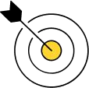

DELIVERABLES
The objective of the system is to minimize the number of human-computer interactions, speed up the identiﬁcation process, and improve the usability of the graphical user interface compared to existing manual systems.
Classifying diﬀerent fruits and even vegetables is not a simple task due to several similarities in shape, size and color. Fruits, vegetables and crops are usually inspected by an expert or trained personnel before being harvested and placed on the market. Some of the factors that these people take into account when evaluating the quality are the color and texture of the products. However, manual review and classiﬁcation lead to several possible human errors. For classiﬁcation to be successful, people trained to examine products must have consistent recognition and analysis
perhaps diﬃcult or tiresome when repeated.
@centuriton
@centuriton
@centuriton
t.me/centuRITon
www.centuriton.com

Slide 4

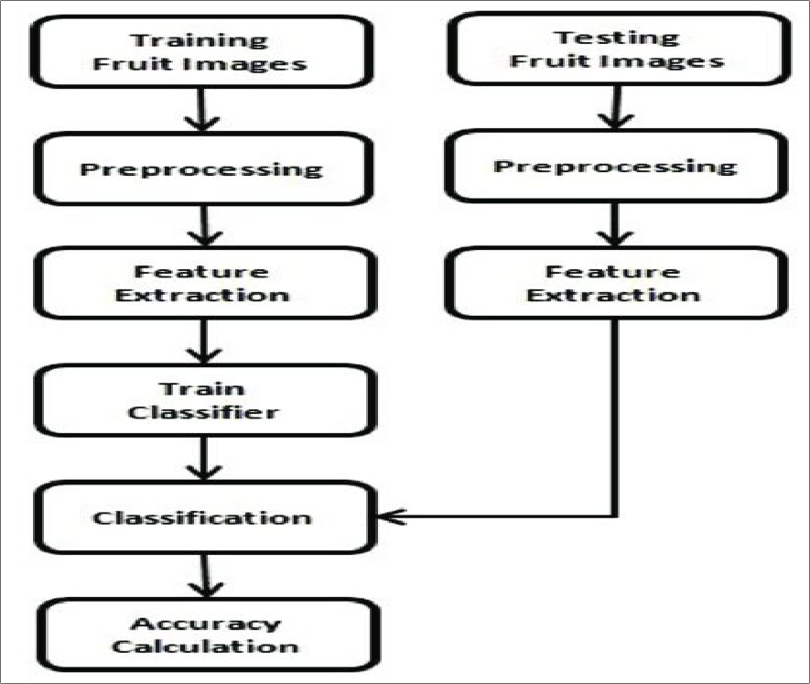
METHODOLOGY/APPROACH
Images are important components in machine learning algorithms as well as in several applications like feature extraction, object detection, and object classiﬁcation. One study focused on the proposal of a fruit detection method that uses machine vision. From an illumination-compensated image, a modiﬁed green and red chromatic diagram was produced. Illustrated below is an overview of the procedure proposed in this study, which can also be applied in the detection and classiﬁcation of other kinds of fruits that will focus on the process of image processing, enhancement, and
illumination.
@centuriton
@centuriton
@centuriton
t.me/centuRITon
www.centuriton.com

Slide 5

TECH STACK
The goal is to build an accurate, fast and reliable fruit detection system, which is a crucial element of an autonomous agricultural robotics platform; is a key element for fruit yield estimation and automated harvesting.Algorithm used here are Teansorflow, numpy, pil and Flask.
@centuriton
@centuriton
@centuriton
t.me/centuRITon
www.centuriton.com

Slide 6

TEAM DETAILS
TERRIFIC TRIO
NAME | EMAIL
RANGANAYAGI K S | ranganayagi.ec21@bitsathy.ac.in
NIVASHINI S | nivashini.ec21@bitsathy.ac.in
RITHIKA S | rithika.ec21@bitsathy.ac.in
@centuriton
@centuriton
@centuriton
t.me/centuRITon
www.centuriton.com

